Slide 1
Artificial intelligence
First-Order Logic

Slide 2
Notice
Presentation slides will be available for download along with the recording of this review session.
You are free to take pictures regardless if you’d like.

Slide 3
DISCLAIMER
I have tried to pull all information from the slides, the textbook, and other authorized resources, but I cannot guarantee the veracity of any information in the slides hereafter.
See presentation notes for sources (chapter pages are for 4th ed.)

Slide 4
Outline
FOL in the logics landscape
Syntax & semantics for FOL
Notes:
Chapter08.pdf slide 2

Slide 5
Intro to First Order Logic
A logic among others

Slide 6


Mama Mia
Propositional logic has limited expressive power.
For Wumpus World
Can’t say “pits cause breezes in adjacent squares”
Must have 64 rules each for pits, breeze, etc.
Propositional logic is declarative.
Declarative – pieces of syntax corresponds to facts
First-order logic (FOL) expands to objects, relations, and functions!
Notes:
Chapter08.pdf slide 3, Mario images pulled from mario.nintendo.com (https://mario.nintendo.com/static/f350c31adcd6378b913f7660db299714/f0970/mario.png , https://mario.nintendo.com/static/c3dae4617cec36bb6591b8f935bd7b21/e49c4/character-3.png )
- While propositional logic would be limited to 64 rules to express the breeze, FOL can express it in a single function/relation

Slide 7
A Whole New World
​ | First-Order Logic | Propositional Logic
Objects | People, houses, numbers, theories, etc. | Propositional symbols (true/false values)
Relations / Functions | Red, round, brother of, owns, father of, logical connectives, etc. | Logical connectives
Notes:
Chapter08.pdf slide 4
- Notable that objects can have attributes that relations/functions can act upon!

Slide 8
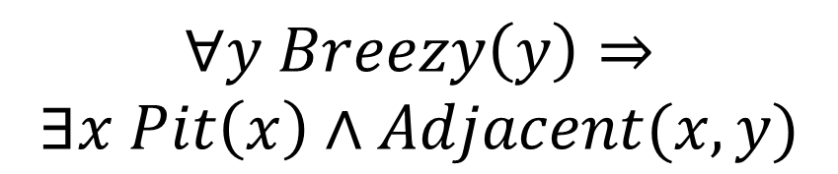
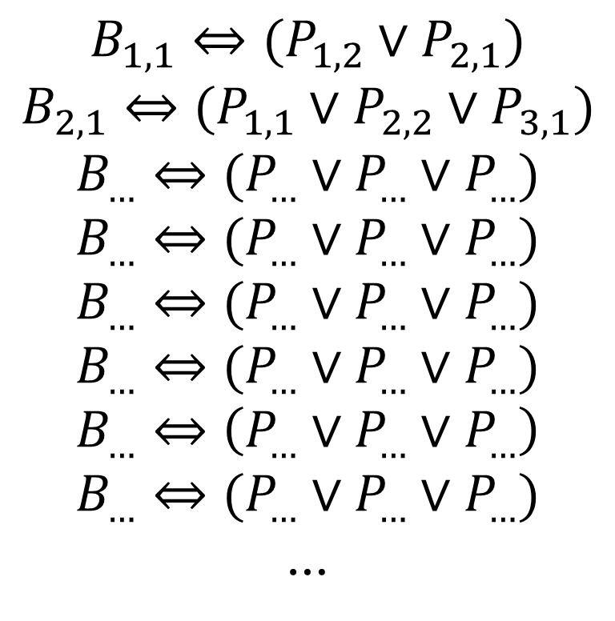
This Bad Boy Can Fit SO Many Propositions In It
Propositional Logic
$$B_{1,1}⇔(P_{1,2}∨P_{2,1})$$
$$B_{2,1}⇔(P_{1,1}∨P_{2,2}∨P_{3,1})$$
$$B_{…}⇔(P_{…}∨P_{…}∨P_{…})$$
$$B_{…}⇔(P_{…}∨P_{…}∨P_{…})$$
$$B_{…}⇔(P_{…}∨P_{…}∨P_{…})$$
$$B_{…}⇔(P_{…}∨P_{…}∨P_{…})$$
$$B_{…}⇔\left(P_{…}∨P_{…}∨P_{…}\right)$$
$$B_{…}⇔(P_{…}∨P_{…}∨P_{…})$$
…
First-Order Logic
$$∀y Breezy\left(y\right)⇒$$
$$∃x Pit\left(x\right)∧Adjacent(x, y)$$
Notes:
Chapter07.pdf slide 36, Chapter08.pdf slide 26
- First Order Logic makes our lives much simpler, and allows us to represent more complex ideas with relative ease

Slide 9
Modeling Reality: Table of Contents
Language​ | Ontological Commitment | Epistemological Commitment
Propositional logic | Facts | True/false/unknown
First-order logic | Facts, objects, relations | True/false/unknown
Temporal logic | Facts, objects, relations, times | True/false/unknown
Probability theory | Facts | Degree of belief
Fuzzy logic | Facts + degree of truth | Known interval value
Notes:
Chapter08.pdf slide 5

Slide 10
FOL Syntax & Semantics
Speaking in the first order

Slide 11
A Grand Fantastic Point of View
FOL expands from and adds to propositional logic syntax!
Symbols are expanded from propositional logic to:
Constants – Objects
Predicates – Relations (always maps to T/F)
Functions – Functions (can return objects, T/F, etc.)
Notes:
Chapter08.pdf slide 6, Book Chapter 8 pgs. 7-8
- Note that just like in proposition logic, we have literals (both positive and negative) made from symbols.

Slide 12
Symbols vs. The Cooler Symbols
FOL Objects
John = {Attributes={Person, King, …}, Brother={Richard}}
Propositional Logic Symbols
A = true
B = false
FOL Predicates
3 > 2 = true
2 > 3 = false
FOL Symbols
FOL Functions
IsEven(x) = x % 2 == 0
NumOfAttributes(x) = len(x.Attributes)
∀x, y HaveAChild(x, y) ⇔ ∃z Parent(x, z) ∧ Parent(y, z)
Notes:
Chapter08.pdf slide 6, Book Chapter 8 pgs. 7-8
- Objects could be KingJohn, Richard, Crown, etc.
- Relations can be greater/lesser than, is someone a brother of someone else
- Functions can be anything, square root of, get adjacent squares, etc.

Slide 13
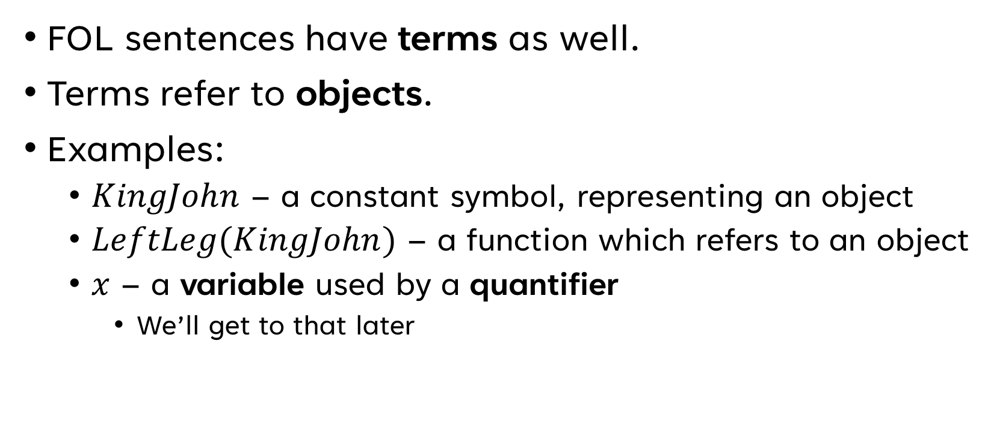
Words for Things
FOL sentences have terms as well.
Terms refer to objects.
Examples:
$KingJohn$ – a constant symbol, representing an object
$LeftLeg(KingJohn)$ – a function which refers to an object
$x$ – a variable used by a quantifier
We’ll get to that later
Notes:
Chapter08.pdf slides 6-9, Book Chapter 8 pgs. 7-10

Slide 14
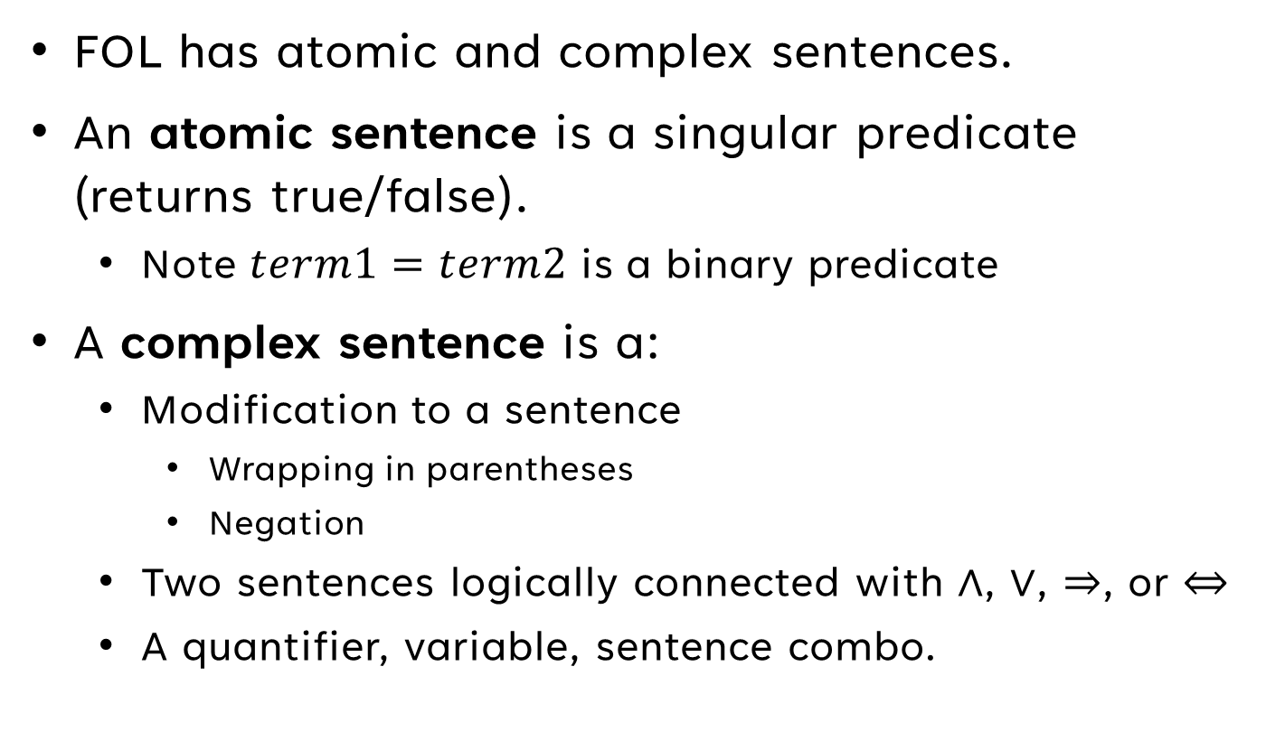
Words for Conclusions About Things
FOL has atomic and complex sentences.
An atomic sentence is a singular predicate (returns true/false).
Note $term1=term2$ is a binary predicate
A complex sentence is a:
Modification to a sentence
Wrapping in parentheses
Negation
Two sentences logically connected with $∧$, $∨$, $⇒$, or $⇔$
A quantifier, variable, sentence combo.
Notes:
Chapter08.pdf slides 7-8, Book Chapter 8 pg. 10

Slide 15
Sentence Inception
Complex
sentence
$$∀y Breezy\left(y\right)⇒∃x Pit\left(x\right)∧Adjacent(x, y)$$
Quantifier
Complex Sentence
Variable
$$Breezy\left(y\right)⇒∃x Pit\left(x\right)∧Adjacent(x, y)$$
Atomic Sentence/
Function
Logical
Connective
Complex Sentence
Notes:
Chapter08.pdf slides 6-8, Book Chapter 8 pgs. 7-11

Slide 16
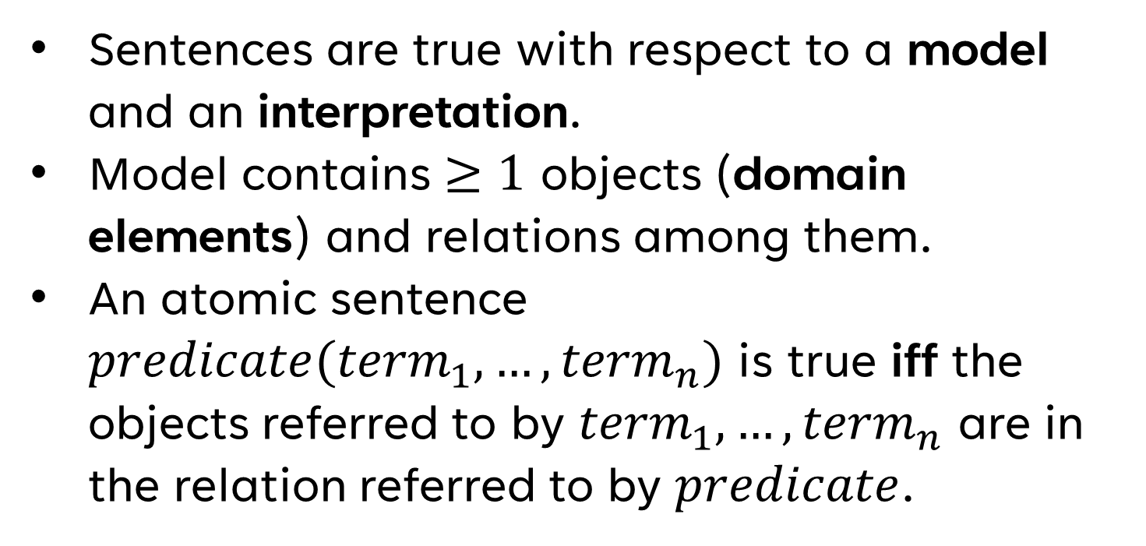
Handling the Truth (Which We Can Do)
Sentences are true with respect to a model and an interpretation.
Model contains $≥1$ objects (domain elements) and relations among them.
An atomic sentence $predicate({term}_{1},…,{term}_{n})$ is true iff the objects referred to by ${term}_{1},…,{term}_{n}$ are in the relation referred to by $predicate$.
Notes:
Chapter08.pdf slide 9

Slide 17
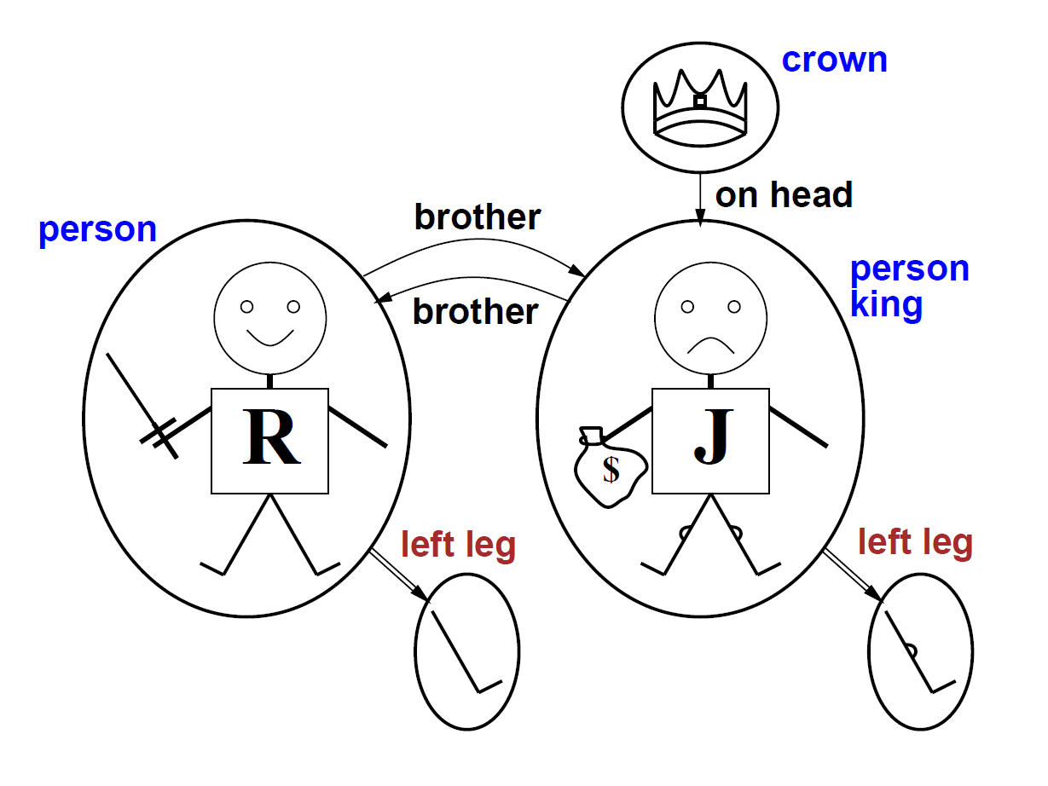
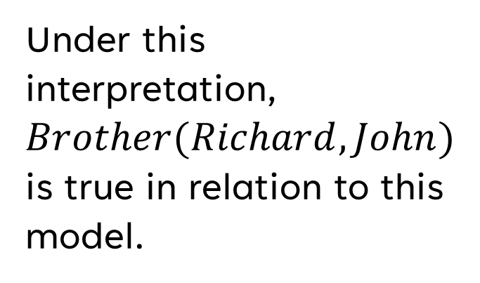



Models for FOL
$$Brother$$
The Brotherhood Relation
Under this interpretation, $Brother(Richard, John)$ is true in relation to this model.
$$Richard$$
Richard the Lionheart
$$John$$
Evil King John
Notes:
Chapter08.pdf slides 10-11

Slide 18
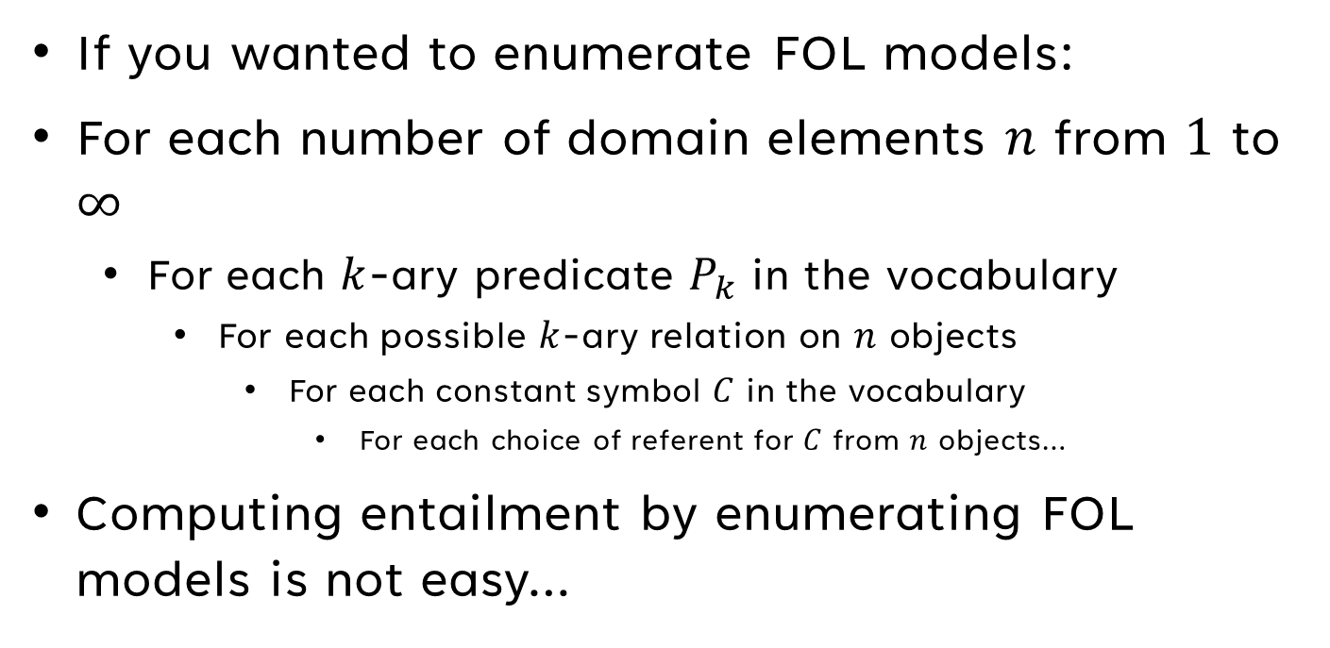
FOL Models (To Infinity and Beyond)
If you wanted to enumerate FOL models:
For each number of domain elements $n$ from $1$ to $∞$
For each $k$-ary predicate $P_{k}$ in the vocabulary
For each possible $k$-ary relation on $n$ objects
For each constant symbol $C$ in the vocabulary
For each choice of referent for $C$ from $n$ objects…
Computing entailment by enumerating FOL models is not easy…
Notes:
Chapter08.pdf slide 12

Slide 19

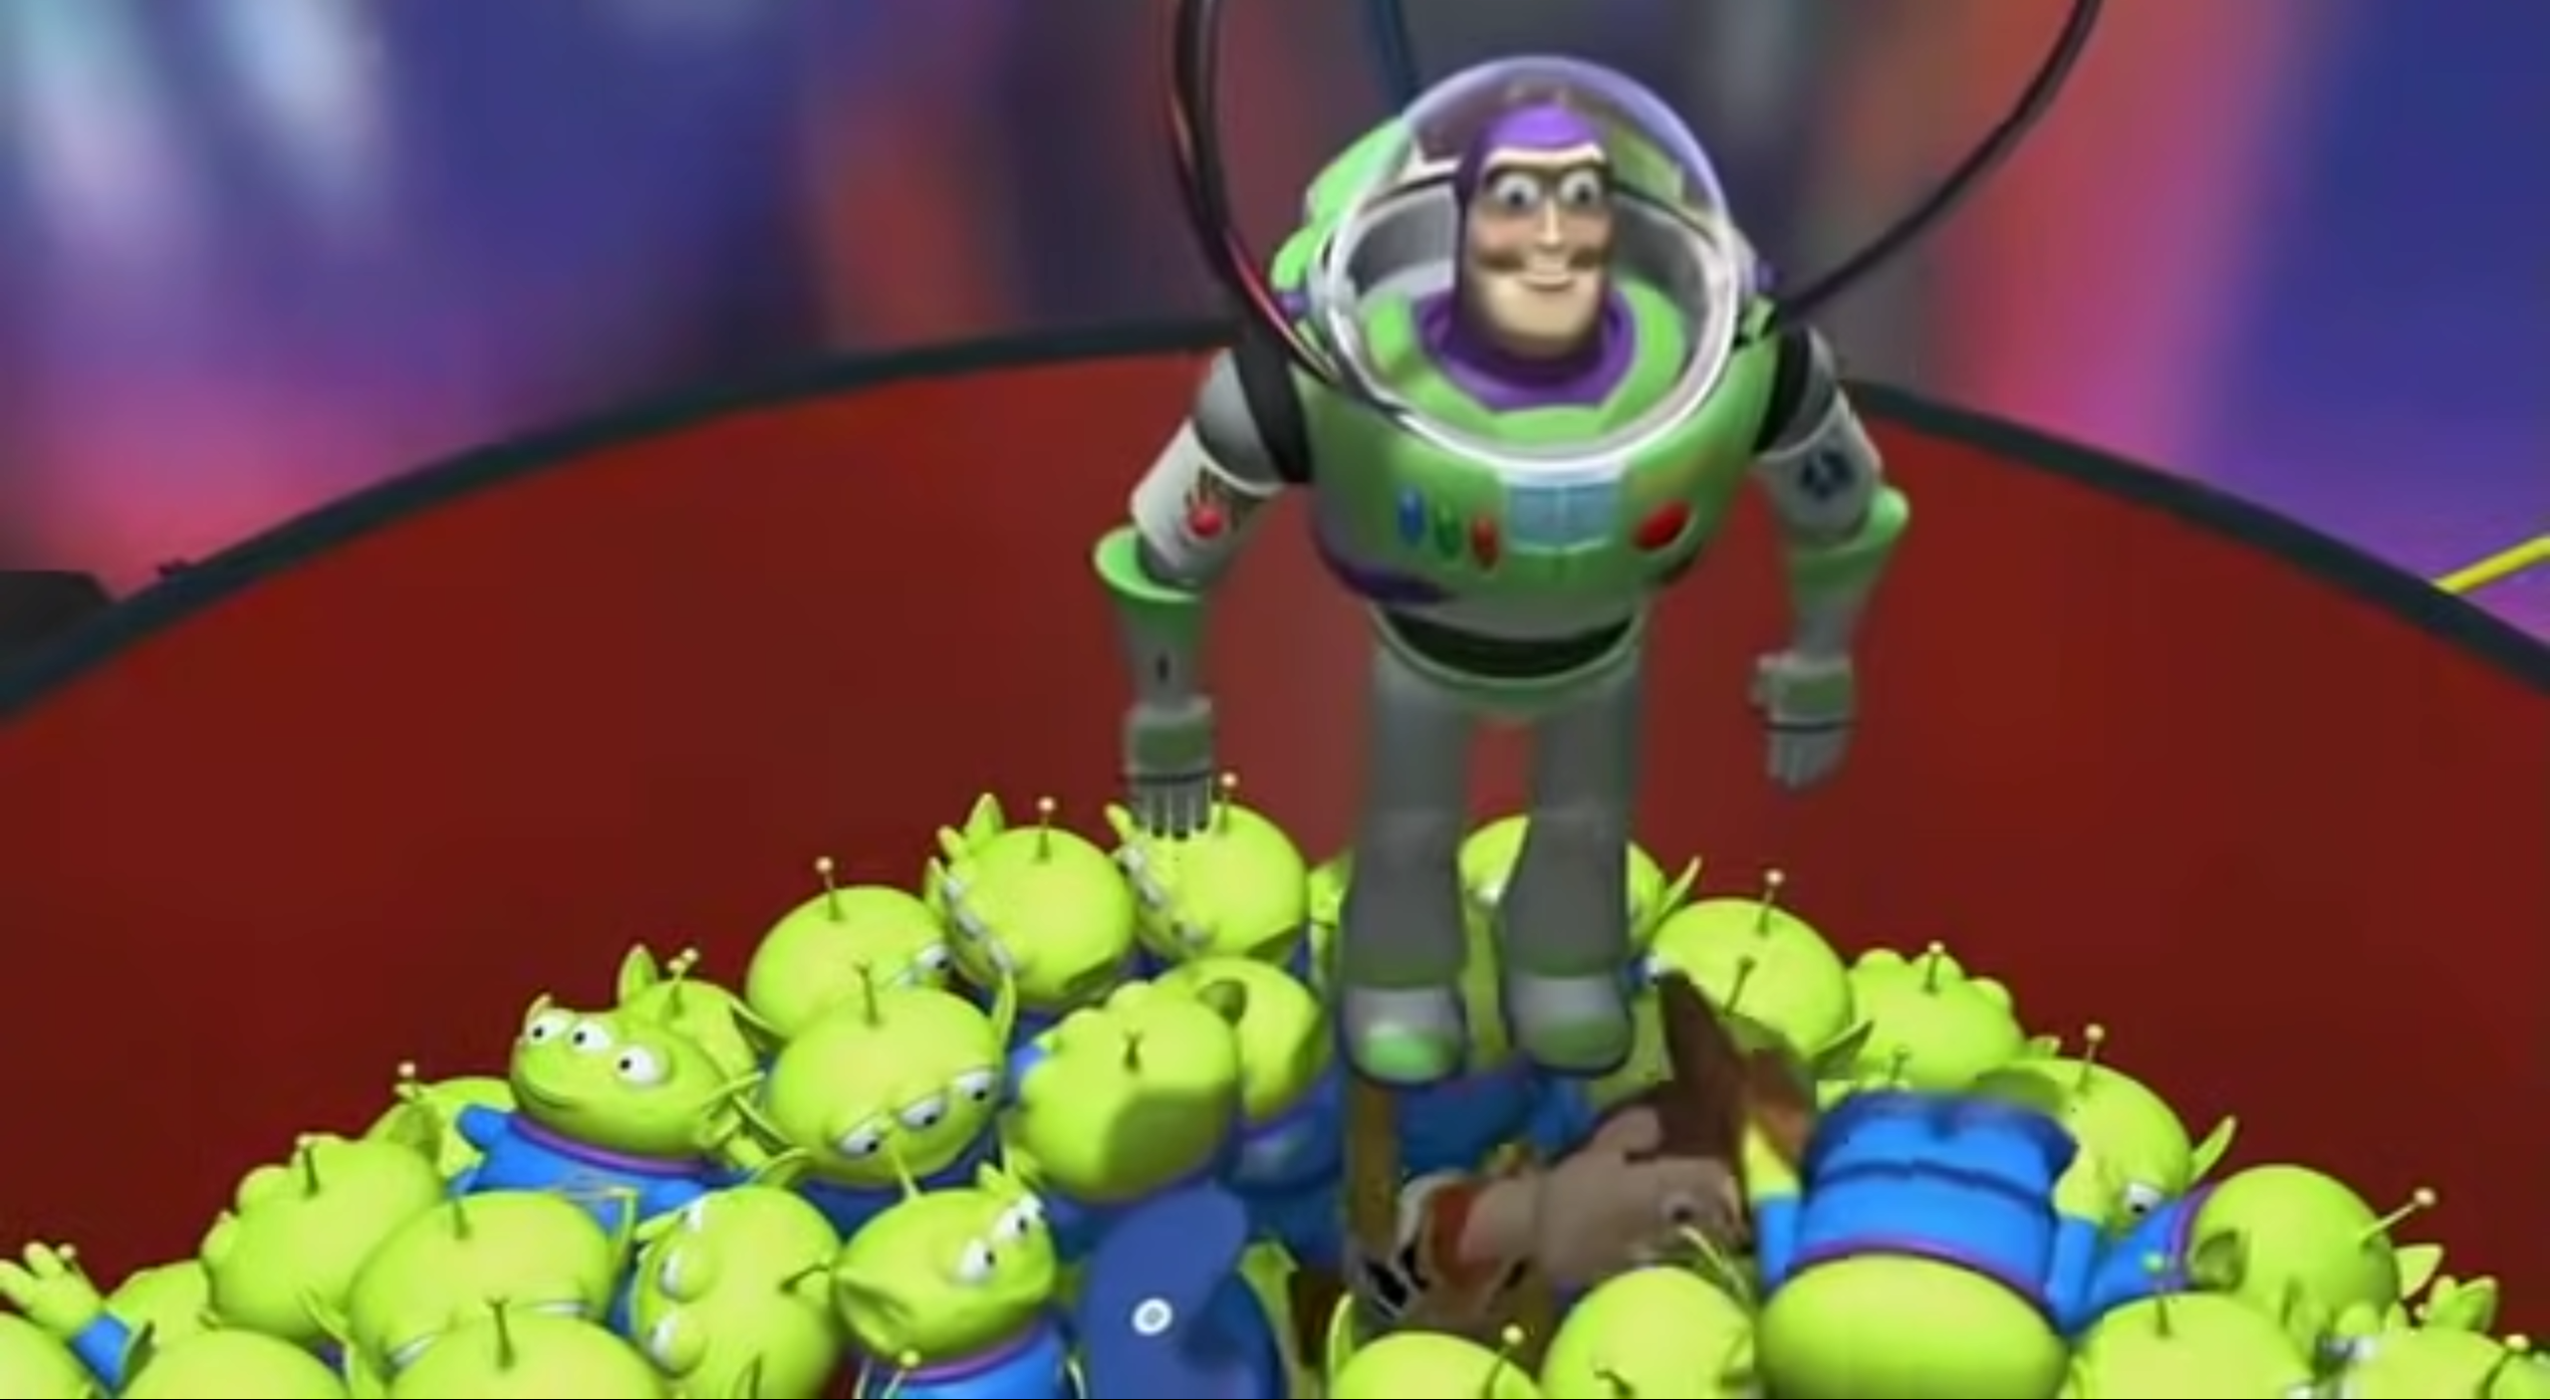
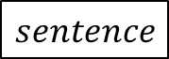

Universal vs. Existential Quantifiers
$$sentence$$
true
$$sentence$$
false
true
false
true
false
true
Notes:
“The Miraculous Catch of Fish”
Other image is from Toy Story (1995)
With universal quantifiers, we’re saying: this sentence applies to all objects. We’re casting a wide net.
With existential quantifiers, we’re trying to select an object which is compatible with the condition, we don’t expect all of the objects to be compatible with the condition, or even many of them to be compatible with the condition.

Slide 20
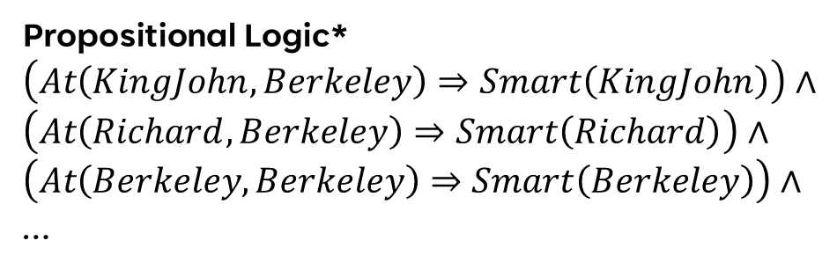

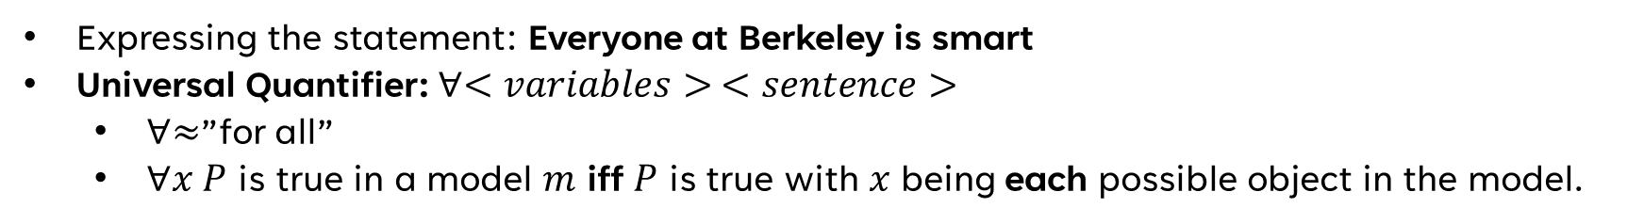
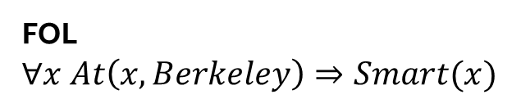
Universal Quantification
Expressing the statement: Everyone at Berkeley is smart
Universal Quantifier: $∀<variables> <sentence>$
$∀≈$”for all”
$∀x P$ is true in a model $m$ iff $P$ is true with $x$ being each possible object in the model.
Propositional Logic*
$$\left(At\left(KingJohn, Berkeley\right)⇒Smart\left(KingJohn\right)\right)∧$$
$$\left(At\left(Richard, Berkeley\right)⇒Smart\left(Richard\right)\right)∧$$
$$\left(At\left(Berkeley, Berkeley\right)⇒Smart\left(Berkeley\right)\right)∧$$
…
Sentence
FOL
$$∀x At\left(x, Berkeley\right)⇒Smart(x)$$
Quantifier
Variable
Additional example: $∀x King(x)⇒Person(x)$
Notes:
Chapter08.pdf slide 13, Book Chapter 8 pgs. 10-12
- Additional example: for all x, if x is a king, then x is a person.
- *Note the propositional logic thing only works if the number of objects compatible with the At relationship is finite, which is not guaranteed.
- Note that converting FOL to proposition logic is called propositionalizing predicate logic.

Slide 21
POP QUIZ!
Why ⇒ instead of ∧?
Notes:
It does not properly handle our prerequisite being false.
What does this mean?
In the truth table for IMPLIES, if the left-hand side (premise) is false, then the statement is still true.
This allows the flexibility for conditionality.
However, with AND, both the left-hand side (premise) and right-hand side (conclusion) must always be true!

Slide 22
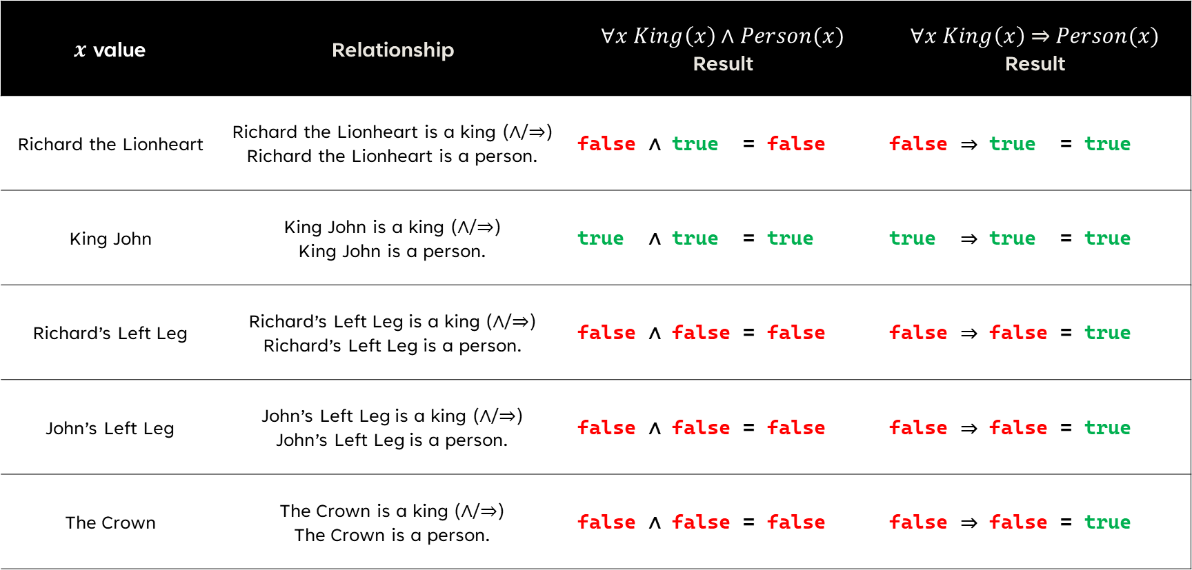
EXAM QUESTION: $∀x King\left(x\right)\left(∧/⇒\right)Person(x)$
​$x$ value | Relationship | $∀x King\left(x\right)∧Person(x)$ Result | $∀x King\left(x\right) \text{⇒} Person(x)$ Result
Richard the Lionheart | Richard the Lionheart is a king (∧/⇒) Richard the Lionheart is a person. | false ∧ true = false | false ⇒ true = true
King John | King John is a king (∧/⇒) King John is a person. | true ∧ true = true | true ⇒ true = true
Richard’s Left Leg | Richard’s Left Leg is a king (∧/⇒) Richard’s Left Leg is a person. | false ∧ false = false | false ⇒ false = true
John’s Left Leg | John’s Left Leg is a king (∧/⇒) John’s Left Leg is a person. | false ∧ false = false | false ⇒ false = true
The Crown | The Crown is a king (∧/⇒) The Crown is a person. | false ∧ false = false | false ⇒ false = true
Notes:
Chapter08.pdf slides 13-14, Book Chapter 8 pgs. 10-12
- If we use the AND relationship, it means everything is a king and everything is a person, and the sentence is false.
- If we use the IMPLIES relationship, it means everything that is a king is also a person, and the sentence is true.
- With the universal quantifier, we’re casting a broad net, we want broad rules that can apply to everything.

Slide 23
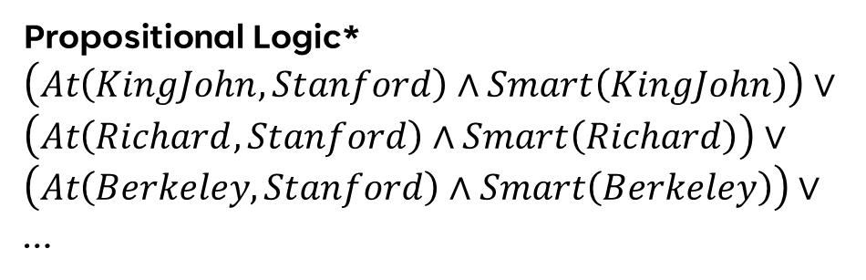
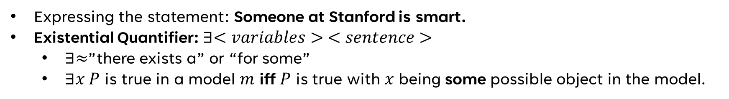
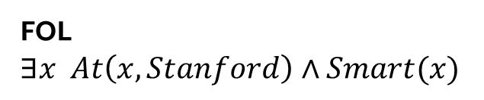
Existential Quantification
Expressing the statement: Someone at Stanford is smart.
Existential Quantifier: $∃<variables> <sentence>$
$∃≈$”there exists a” or “for some”
$∃x P$ is true in a model $m$ iff $P$ is true with $x$ being some possible object in the model.
Propositional Logic*
$$\left(At\left(KingJohn, Stanford\right)∧Smart\left(KingJohn\right)\right)∨$$
$$\left(At\left(Richard,Stanford\right)∧Smart\left(Richard\right)\right)∨$$
$$\left(At\left(Berkeley,Stanford\right)∧Smart\left(Berkeley\right)\right)∨$$
…
Sentence
FOL
$$∃x At\left(x,Stanford\right)∧Smart(x)$$
Quantifier
Variable
Additional example:$∃x Crown(x)∧OnHead(x, John)$
Notes:
Chapter08.pdf slide 15-16, Book Chapter 8 pg. 12
- Additional example: There exists a crown that is on John’s head.
- *Note the propositional logic thing only works if the number of objects compatible with the At relationship is finite, which is not guaranteed.
- Note that converting FOL to proposition logic is called propositionalizing predicate logic.

Slide 24
POP QUIZ!
Why ∧ instead of ⇒?
Notes:
It improperly expands the number of objects for which the condition is true!
Getting a true on an implication only requires that the left side (the premise) is false!
So by using the implication relationship you’re going to get some object that doesn’t really fit what you want!
The conditionality provided by the IMPLICATION relationship is already given by the OR conjunction, or the “there is a” nature

Slide 25
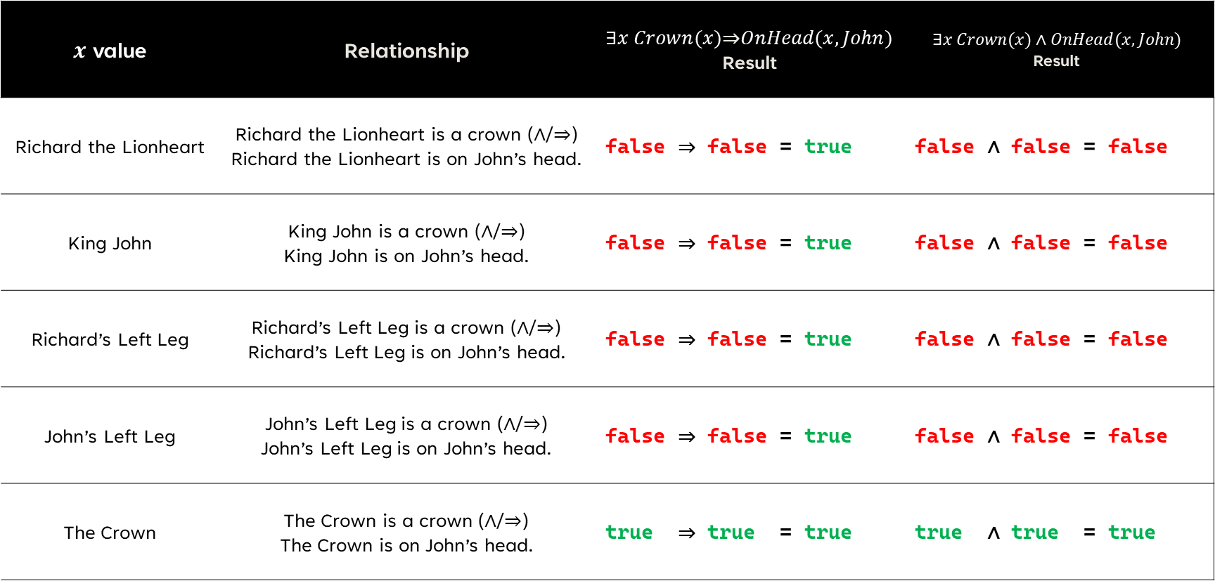
$$∃x Crown(x)\left(⇒/∧\right)OnHead(x, John)$$
​$x$ value | Relationship | $∃x Crown(x)\text{⇒}OnHead(x, John)$ Result | $$∃x Crown(x)∧OnHead(x, John)$$ Result
Richard the Lionheart | Richard the Lionheart is a crown (∧/⇒) Richard the Lionheart is on John’s head. | false ⇒ false = true | false ∧ false = false
King John | King John is a crown (∧/⇒) King John is on John’s head. | false ⇒ false = true | false ∧ false = false
Richard’s Left Leg | Richard’s Left Leg is a crown (∧/⇒) Richard’s Left Leg is on John’s head. | false ⇒ false = true | false ∧ false = false
John’s Left Leg | John’s Left Leg is a crown (∧/⇒) John’s Left Leg is on John’s head. | false ⇒ false = true | false ∧ false = false
The Crown | The Crown is a crown (∧/⇒) The Crown is on John’s head. | true ⇒ true = true | true ∧ true = true
Notes:
Chapter08.pdf slide 15-16, Book Chapter 8 pg. 12
- If we use the AND relationship, it means something is a crown and something is on John’s head.
- If we use the IMPLIES relationship, it means everything that is not a crown satisfies the quantifier.
- Remember with the existential quantifier we’re targeting one (or maybe more) true’s, we’re selecting an object rather than casting a broad net.

Slide 26
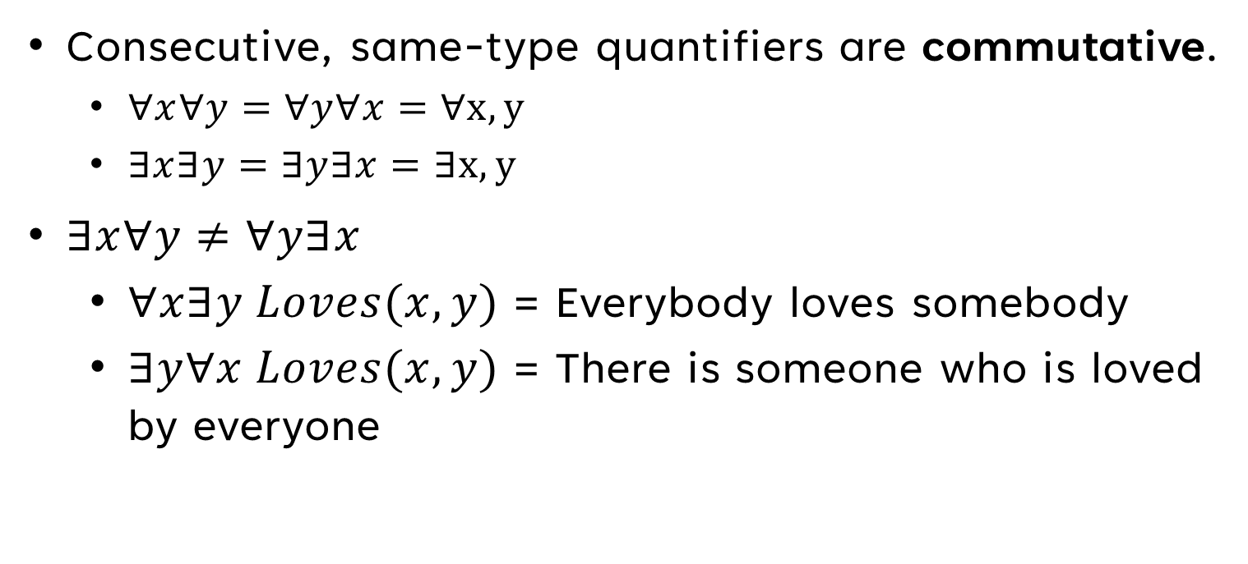
Properties of Quantifiers
Consecutive, same-type quantifiers are commutative.
$∀x∀y=∀y∀x=∀x,y$
$∃x∃y=∃y∃x=∃x,y$
$∃x∀y≠∀y∃x$
$∀x∃y Loves(x,y)$ = Everybody loves somebody
$∃y∀x Loves(x, y)$ = There is someone who is loved by everyone
Notes:
Chapter08.pdf slide 17, Book Chapter 8 pg. 13

Slide 27
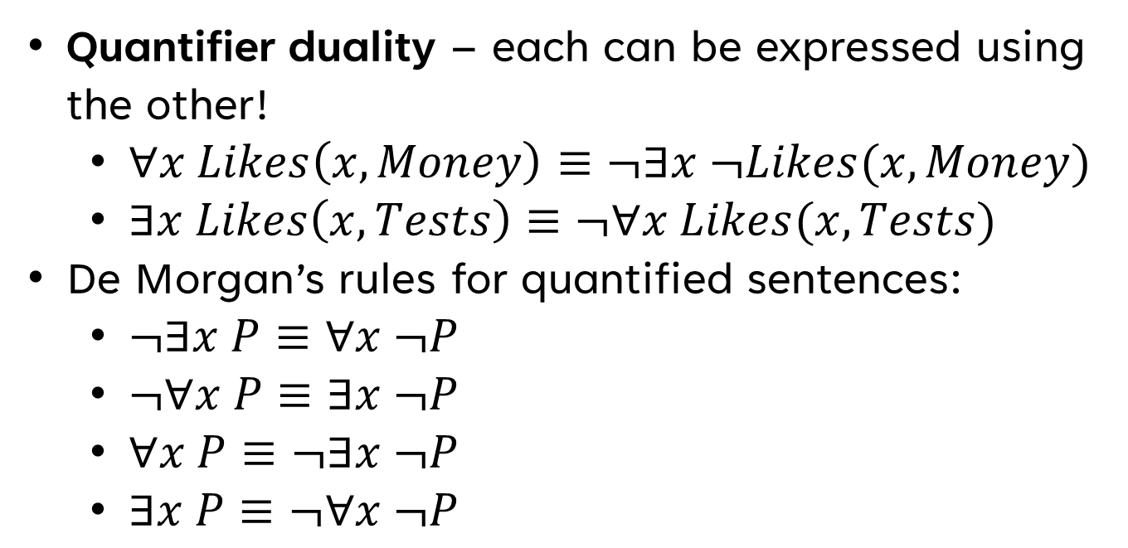
A Quantifier’s Guide to Duality & Negation (EXAM QUESTIONS!)
Quantifier duality – each can be expressed using the other!
$∀x Likes\left(x, Money\right)≡¬∃x ¬Likes(x, Money)$
$∃x Likes\left(x,Tests\right)≡¬∀x Likes(x, Tests)$
De Morgan’s rules for quantified sentences:
$¬∃x P≡∀x ¬P$
$¬∀x P≡∃x ¬P$
$∀x P≡¬∃x ¬P$
$∃x P≡¬∀x ¬P$
Notes:
Chapter08.pdf slide 17, Book Chapter 8 pg. 13, Chapter09.pdf slide 44

Slide 28
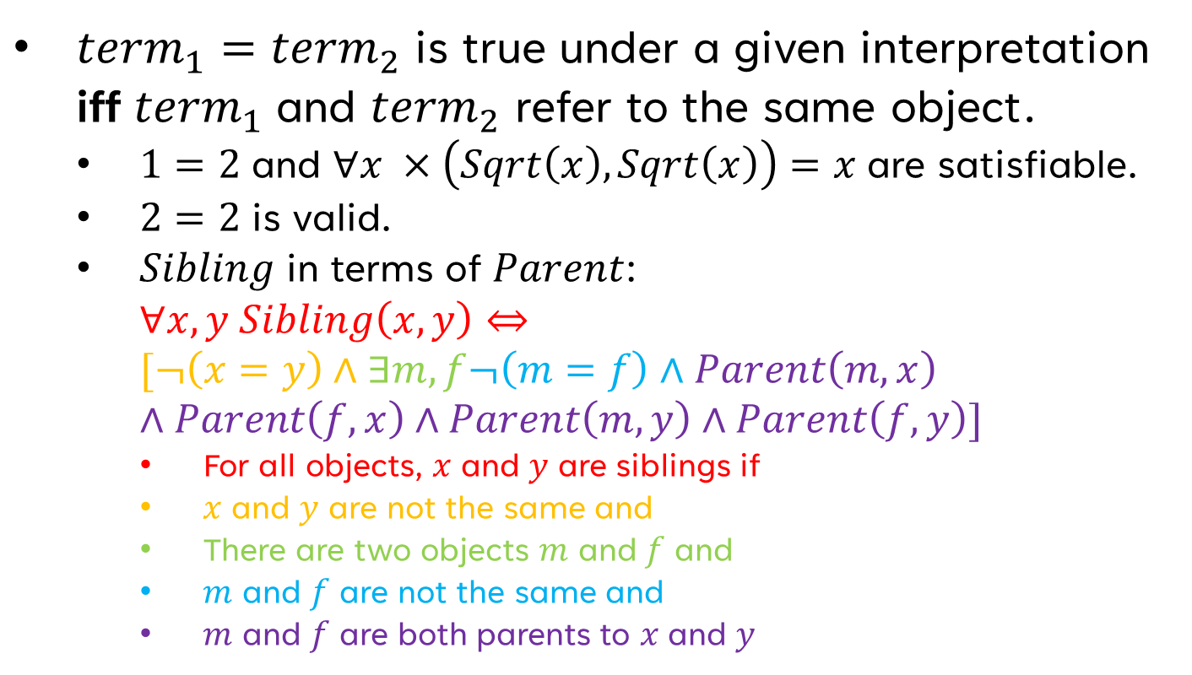
Equality
${term}_{1}={term}_{2}$ is true under a given interpretation iff ${term}_{1}$ and ${term}_{2}$ refer to the same object.
$1=2$ and $∀x ×\left(Sqrt\left(x\right), Sqrt\left(x\right)\right)=x$ are satisfiable.
$2=2$ is valid.
$Sibling$ in terms of $Parent$: $∀x,y Sibling\left(x,y\right)⇔$ $[¬\left(x=y\right)∧∃m,f¬\left(m=f\right)∧Parent\left(m, x\right)∧Parent\left(f, x\right)∧Parent\left(m,y\right)∧Parent\left(f, y\right)]$
For all objects, $x$ and $y$ are siblings if
$x$ and $y$ are not the same and
There are two objects $m$ and $f$ and
$m$ and $f$ are not the same and
$m$ and $f$ are both parents to $x$ and $y$
Notes:
Copied from Chapter08.pdf slide 23, color added
- “Equality symbol signifies that two terms refer to the same object” (Book Chapter 8 pg. 14)

Slide 29
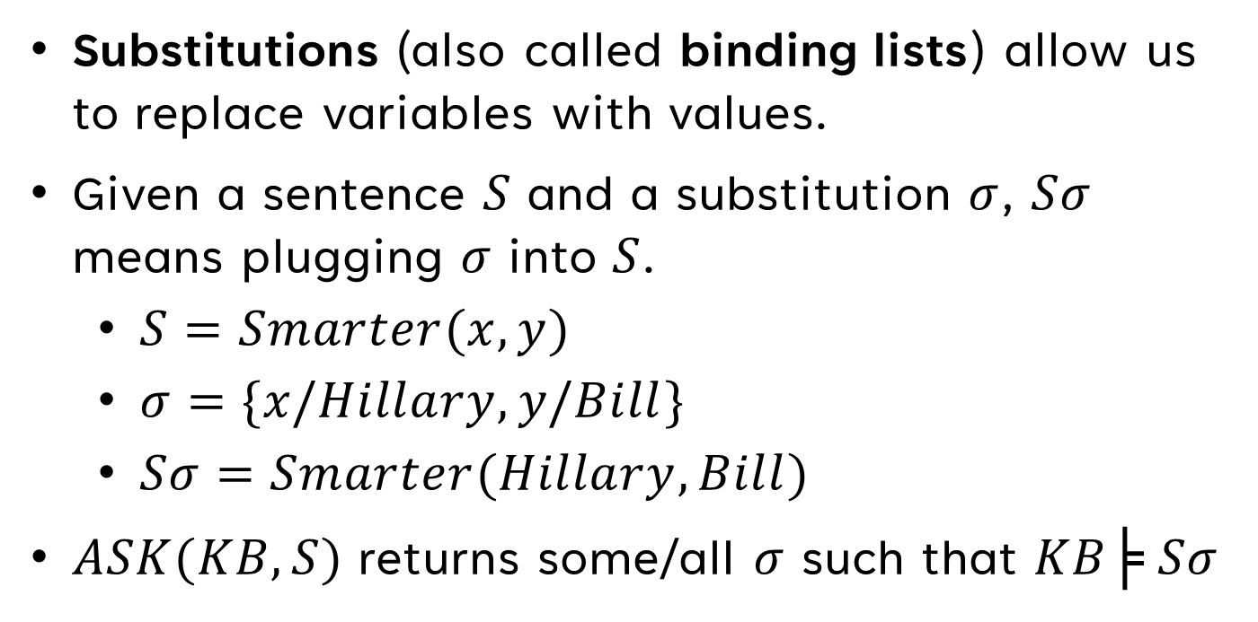
Substitution
Substitutions (also called binding lists) allow us to replace variables with values.
Given a sentence $S$ and a substitution $σ$, $Sσ$ means plugging $σ$ into $S$.
$S=Smarter(x, y)$
$σ=\{x\text{/}Hillary,y\text{/}Bill\}$
$Sσ=Smarter(Hillary,Bill)$
$ASK(KB,S)$ returns some/all $σ$ such that $KB╞ Sσ$
Notes:
Chapter08.pdf slide 24, Book Chapter 8 pgs. 15-16

Slide 30
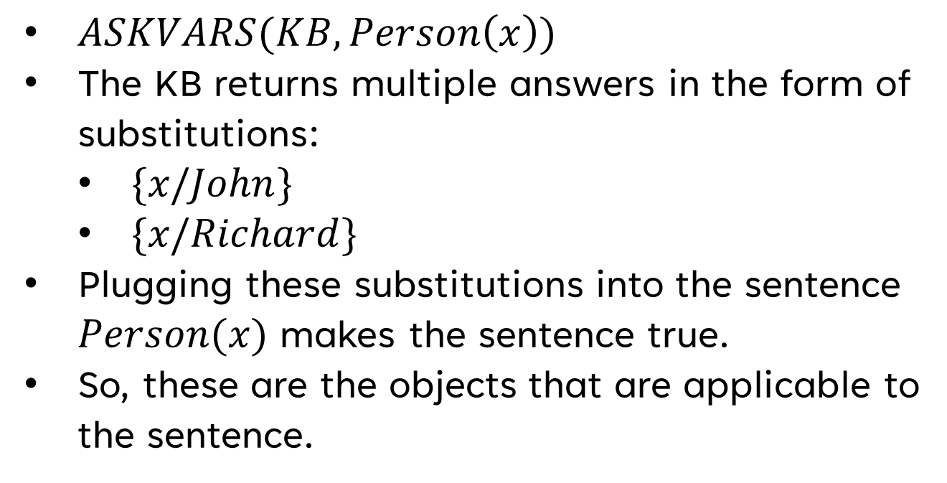
Substitution Regarding KBs
$ASKVARS(KB,Person\left(x\right))$
The KB returns multiple answers in the form of substitutions:
$\{x\text{/}John\}$
$\{x\text{/}Richard\}$
Plugging these substitutions into the sentence $Person(x)$ makes the sentence true.
So, these are the objects that are applicable to the sentence.
Notes:
Book Chapter 8 pg. 16

Slide 31
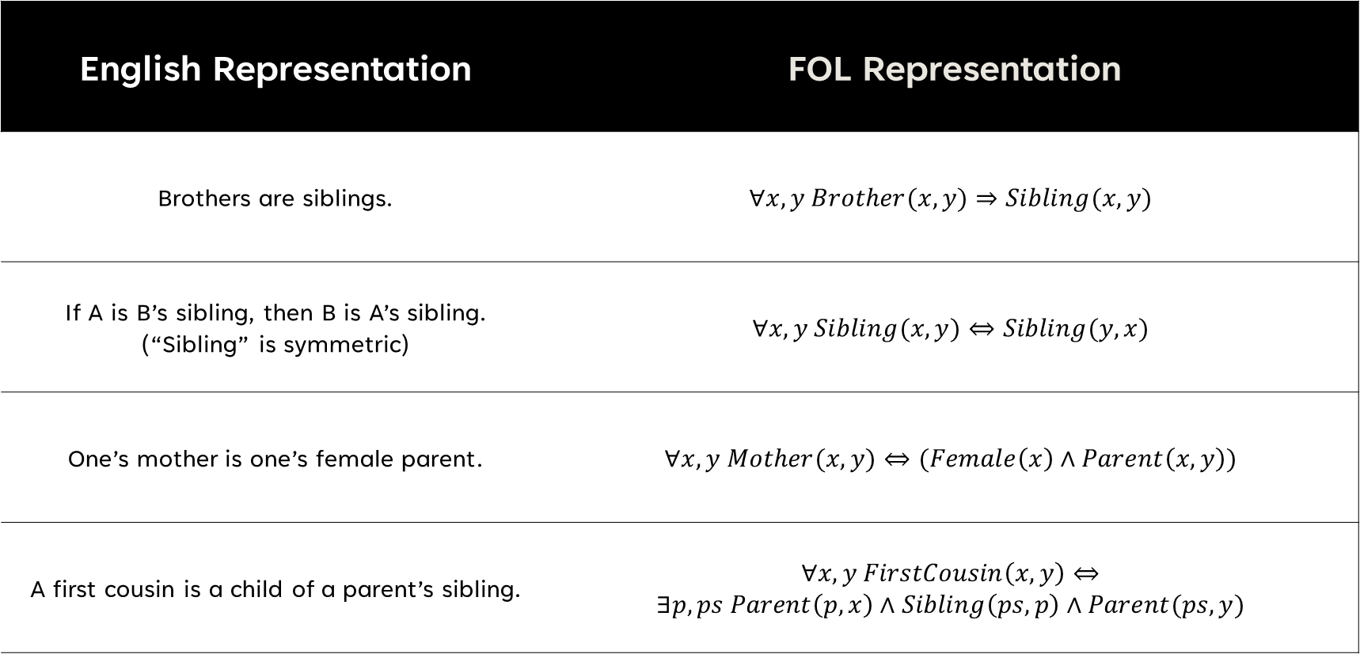
Applying FOL
English Representation​ | FOL Representation
Brothers are siblings. | $$∀x,y Brother(x, y)⇒Sibling(x, y)$$
If A is B’s sibling, then B is A’s sibling. (“Sibling” is symmetric) | $$∀x,y Sibling(x, y)⇔Sibling(y,x)$$
One’s mother is one’s female parent. | $$∀x,y Mother(x, y)⇔(Female\left(x\right)∧Parent\left(x, y\right))$$
A first cousin is a child of a parent’s sibling. | $$∀x,y FirstCousin\left(x, y\right)⇔$$ $$∃p,ps Parent\left(p, x\right)∧Sibling\left(ps, p\right)∧Parent(ps, y)$$
Notes:
Chapter08.pdf slides 18-22, Book Chapter 8 pgs. 16-17

Slide 32
THANK YOU
Joshua Sheldon
jsheldon2022@my.fit.edu

